Slide 1
COPADS
#09 – Public Key Encryption
IFEOLUWATAYO IGE

Slide 2
OUTLINE
Asymmetric Encryption- Public Key Encryption
Digital Signature

Slide 3
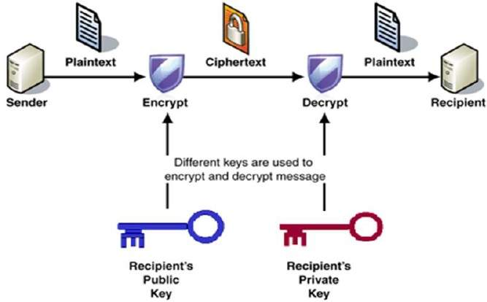
Public Key Encryption (Asymmetric)
SCENARIO
Alfred chooses a public encryption key E_{K} and a corresponding private decryption key D_{K}
Alfred publishes his public key
Anyone can now encrypt a message and send it to Alfred using the public keys
Only Alfred can decrypt these messages using the private key

Slide 4
Public Encryption Properties
Different keys are used for encryption and decryption
The receiver needs to publish an encryption key, referred to as his public key.
He also possesses a unique decryption key, generally referred to as his private key.
Though private and public keys are related mathematically, it is not feasible to calculate the private key from the public key
A popular and widely used public key encryption algorithm is RSA.
Invented by Ronald Rivest, Adi Shamir, and Leonard Adleman in 1978
generates a pair of commutative keys (encrypt with one, decrypt with the other). A private key can be used to encrypt, and its corresponding public key is used for decryption and vice-versa
Has RSA been broken? Some researchers argue that quantum computing could be used to crack RSA-2048 (bit-size)
The RSA involves three phases; Key Generation (public and private key), encryption, and decryption.
https://quantumzeitgeist.com/has-rsa-2048-been-cracked-with-a-quantum-computer/#:~:text=Researcher%20Ed%20Gerck%20has%20announced,%E2%80%9D%2C%20is%20a%20dear%20friend.

Slide 5
RSA Key Generation Algorithm
1. Find 2 large prime numbers p and q
2. Generate the RSA modulus (n)
n=p*q. For strong unbreakable encryption, let n be a large number
3. Find a Totient function.
Euler totient function. The Totient is represented as ϕ(n) =(p - 1) x (q -1).
Carmichael's totient function. The Totient is represented as λ(n) = lcm(p − 1, q − 1).
Notes:
for primes p, φ(p)=p-1.

Slide 6
4. THE PUBLIC KEY (e, n)
Select a number e that satisfies ALL the following rules:
Must be prime
Must be less than totient
It must not be a factor of the totient (you can use the modulo division to find this. There should be a remainder. If the result is zero, that number can NEVER be used).
5. THE PRIVATE KEY (d, n)
To get d, find a number that obeys the following rule:
d =1/e mod T;
This calculates the modular inverse of e and T. Modular inverse can be derived using the extended Euclidean algorithm
This can also be done using an online Modular multiplicative inverse calculator such as https://planetcalc.com/3311/

Slide 7
RSA Encryption and Decryption
Encryption:
PlainText ^ e MOD n = cipher Text
Decryption:
CipherText ^ d MOD n = PlainText

Slide 8
Example
Generate private and public keys for prime numbers 7 and 11.
p = 7, q=11
n = p * q = 77
T = (p − 1)(q − 1) = 6*10=60
7 can be picked ( you can decide to pick any number that obeys the rules)
The public key is (7,77)
d =1/e mod T;
Using the online calculator https://planetcalc.com/3311/, we have 43.
The private key is (43,77)

Slide 9
From our example, let our plain text m = 9;
To encrypt:
m^{e} mod n = 9⁷ mod 77= 37
To Decrypt:
c^{d} mod n = 37⁴³ mod 77 = 9
To show the Commutative Property of the RSA,
We switch d with e:
Encrypt: 9^ 43 mod 77= 58
Decrypt: 58^7 mod 77= 9
A brief video on RSA:
https://www.youtube.com/watch?v=Pq8gNbvfaoM

Slide 10
Can you try to generate public and private keys from the following:
P = 53 and q = 59.
P= 11 and q=13
P = 7 and q= 19

Slide 11
Digital Signatures
This is a security scheme for verifying the authenticity of digital messages or documents.
It authenticates by verifying the identity of the individual who sends a message. It confirms the sender is not an impostor.
Checks the integrity of data- if the data arrived in the same state as when it was sent.
Provides non-repudiation- prevents the signatory from being able to repudiate (deny) their involvement.
RSA and Elliptic Curve Digital Signature Algorithm (EcDSA) could be implemented for digital signatures
Digital signatures are often used by themselves or in conjunction with encryption in a range of different security protocols such as SecureSHell, TransportLayerSecurity, etc.

Slide 12
Asymmetric Encryption: Digital Signatures
A digital signature scheme typically consists of three algorithms:
A key generation algorithm that selects a private key uniformly at random from a set of possible private keys. The algorithm outputs the private key and a corresponding public key.
A signing algorithm that, given a message and a private key, produces a signature.
A signature verifying algorithm that, given the message, public key, and signature, either accepts or rejects the message's claim to authenticity.
Two main properties are required:
The authenticity of a signature generated from a fixed message and fixed private key can be verified by using the corresponding public key.
Secondly, it should be computationally infeasible to generate a valid signature for a party without knowing that party's private key. Even though Harry has access to the public key, he can not fake a valid signature because he does not have the private key.
Drawback: Impersonation. If your private key is known.

Slide 13
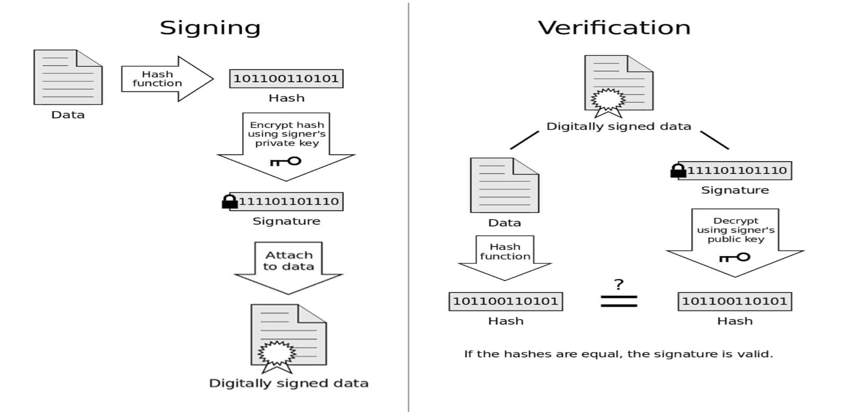
Digital Signatures
M(c) = c^{d} mod n
The value of c is the hash of the message.
The value of d (one part of the sender’s private key)
The value of n is the other part of the sender’s private key,
The value of M (c) is the signature.
RSA decryption is mostly used for digitally signing documents while the formula for RSA encryption is used for verification (m^{e} mod n) with m as the digital signature
Digital Signature Diagram by Acdx licensed under CC0

